Slide 1
Analysis
INTRODUCTION TO
STATISTICAL ANALYSIS AND DECISION MAKING

Slide 2
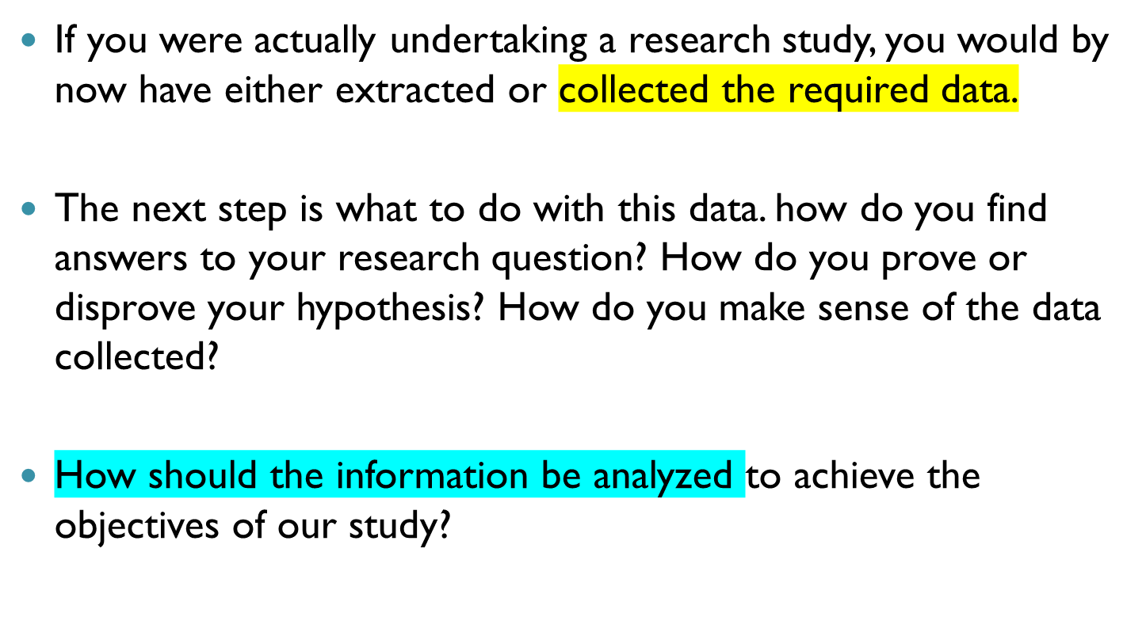
Introduction to part 11

Slide 3
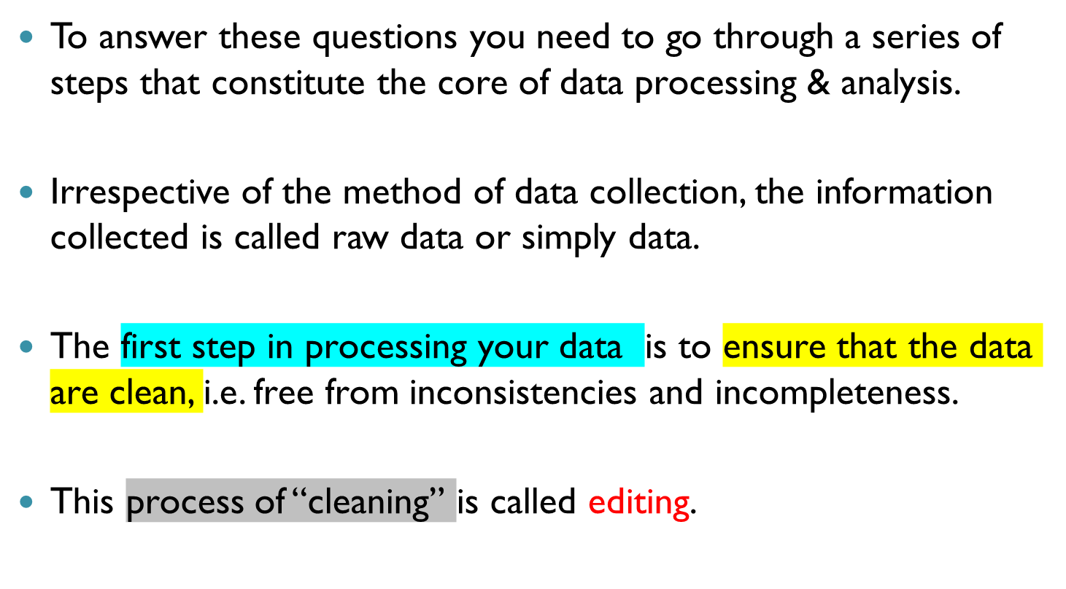
Introduction to part 11

Slide 4
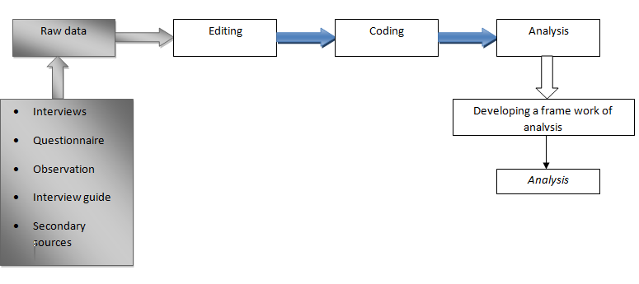
Steps in data processing

Slide 5
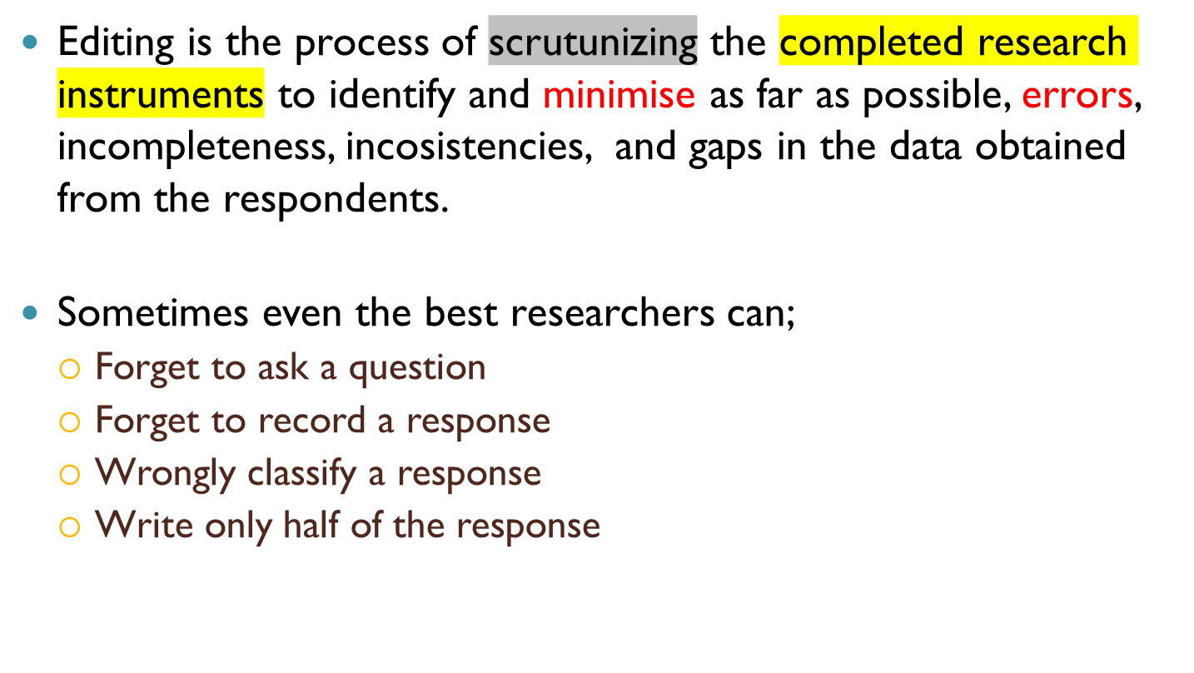
Data Editing

Slide 6
Data editing
Example 1:
A questionnaire meant to be answered by adults over the age of 30 years has also been answered by some persons under the age of 30 years
Example 2:
A respondent gives her birthday as 1865 or claims to have a car insurance but says she doesn‘t own a car

Slide 7
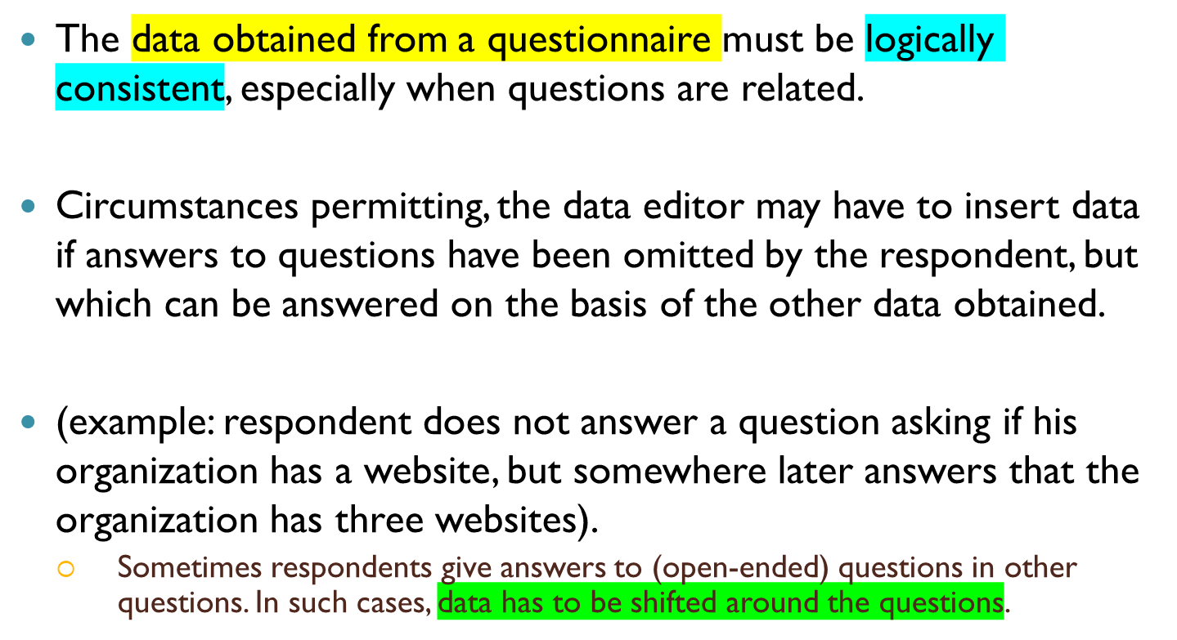
Data Consistency and Completeness

Slide 8
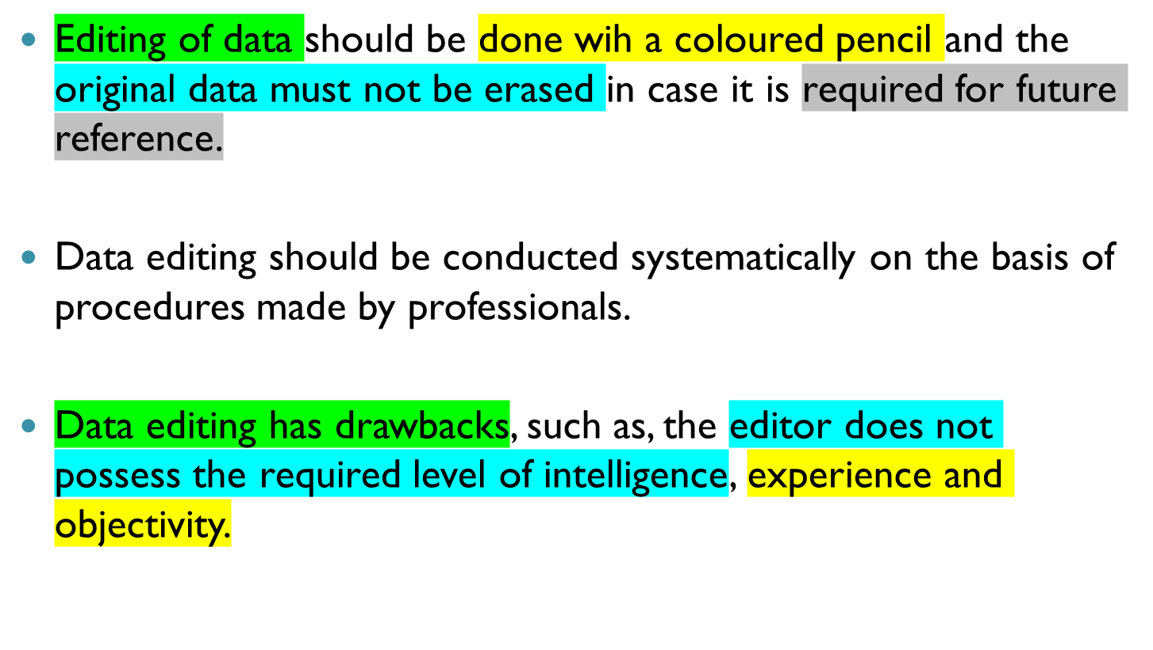
Some Observations while Editing

Slide 9
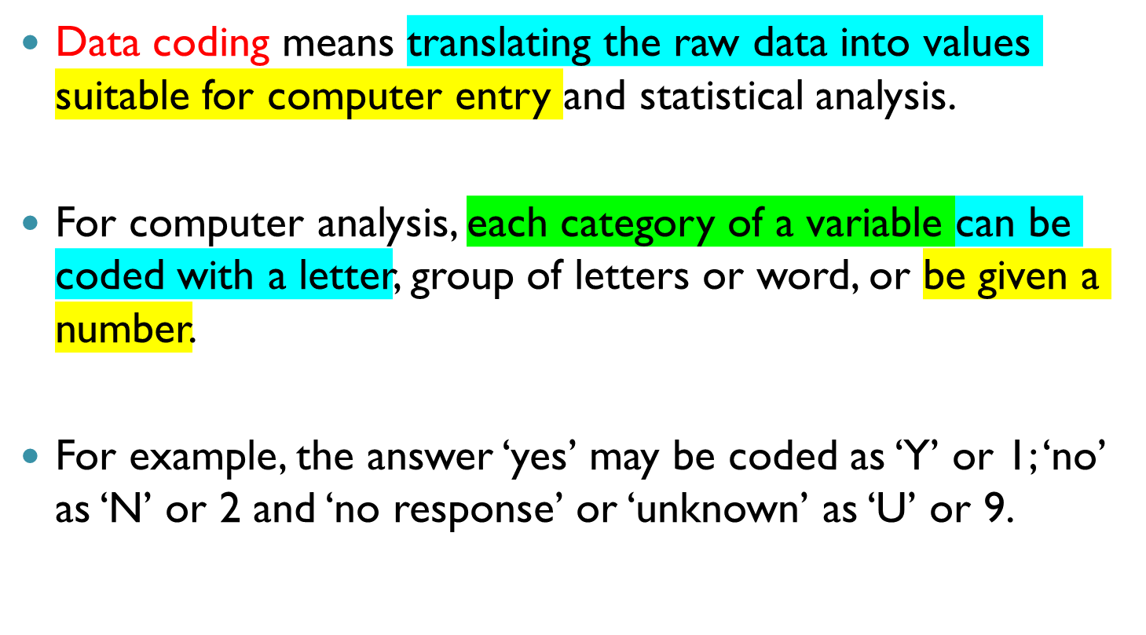
Data Coding

Slide 10
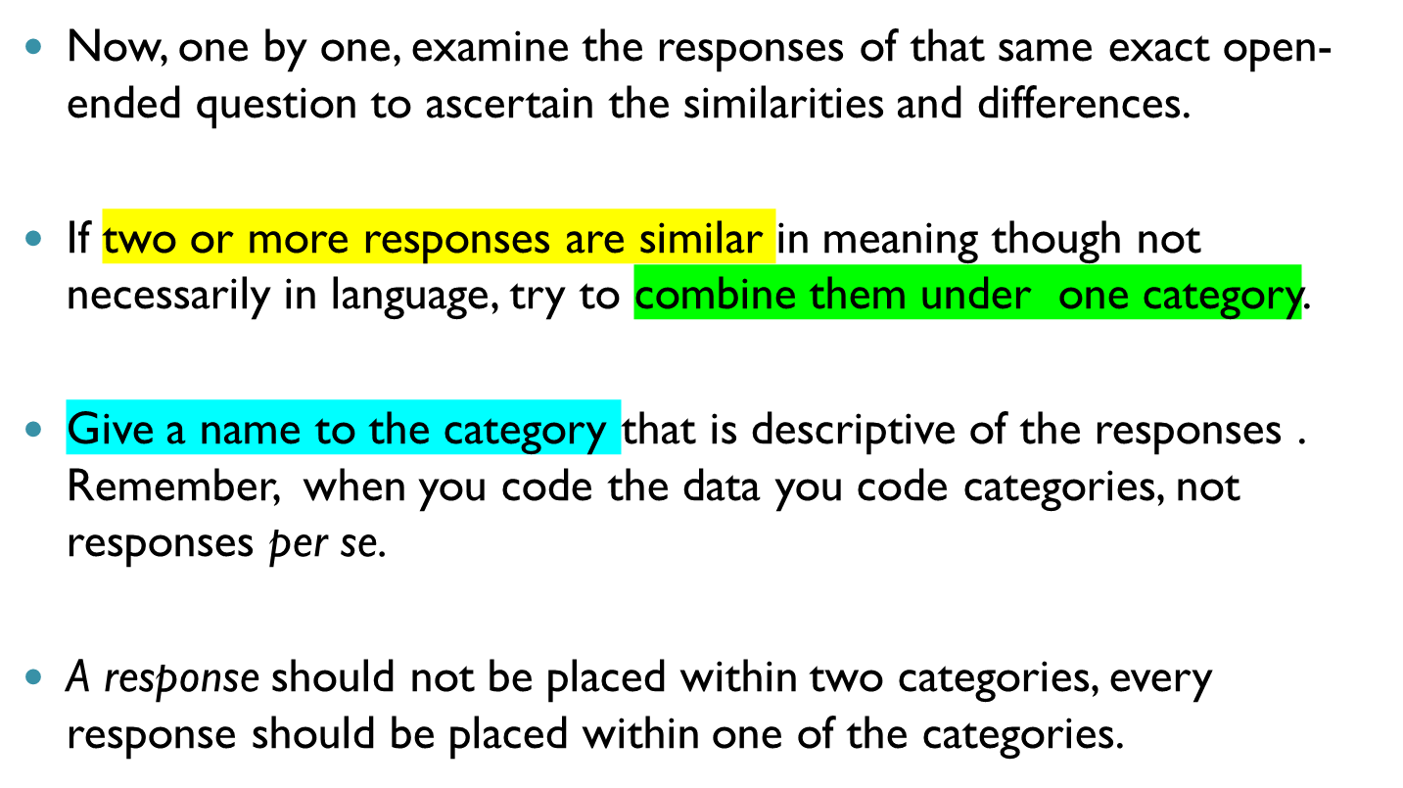
Data Coding open-ended qtns

Slide 11
Data Entry
During data entry, the information relating to each subject in the study is keyed into the computer in the form of the relevant code.
Verification
During data entry, mistakes will definitely creep in. The computer can print out the data exactly as it has been entered, so the printout can be checked visually for obvious errors, (blanks that should not be there, alphabetic codes where numbers are expected, obviously wrong codes).

Slide 12
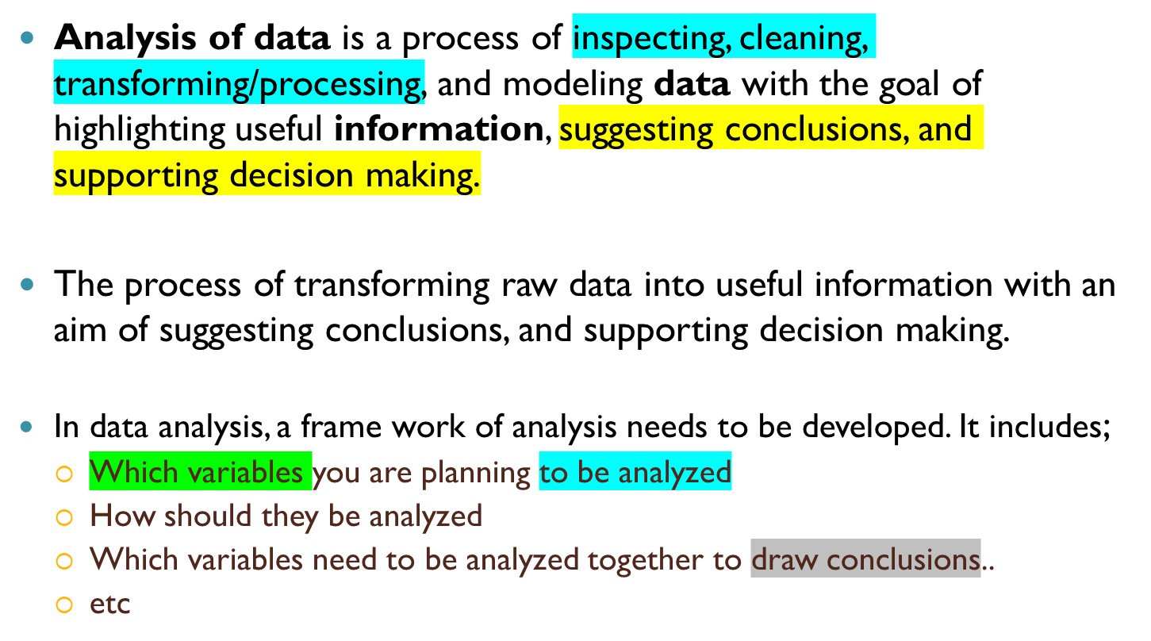
Data Analysis
Notes:
Variables = columns

Slide 13
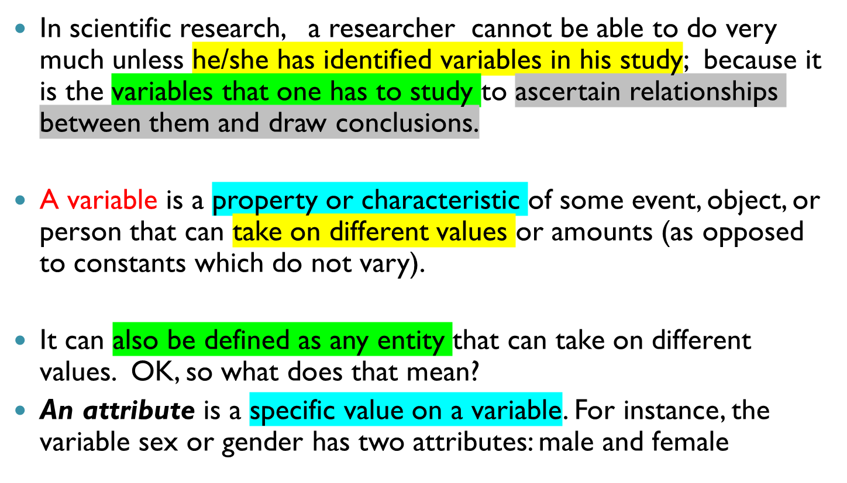
Introduction to variables..

Slide 14
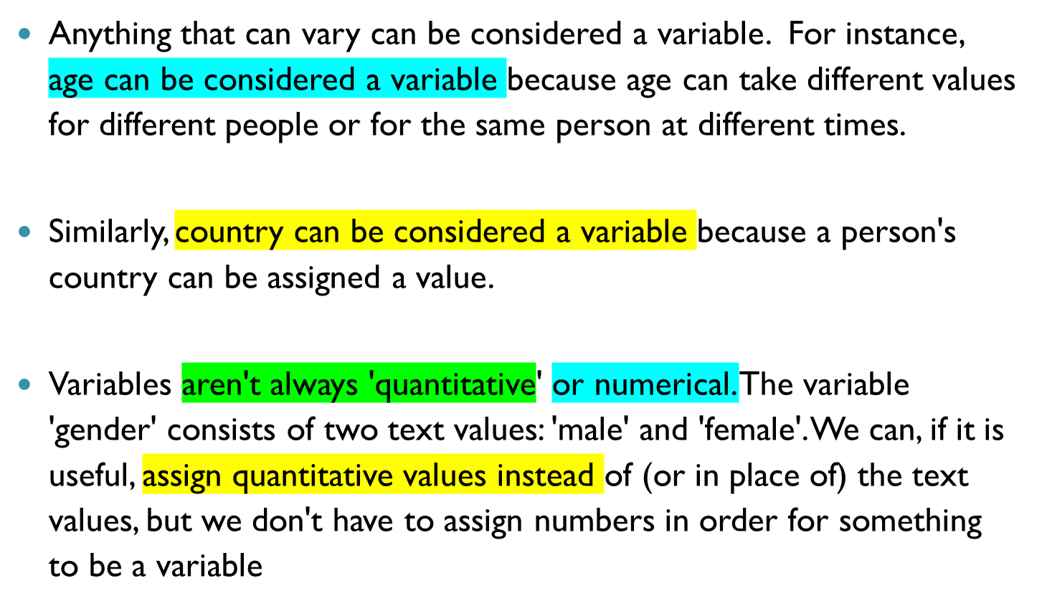
Introduction to variables..

Slide 15
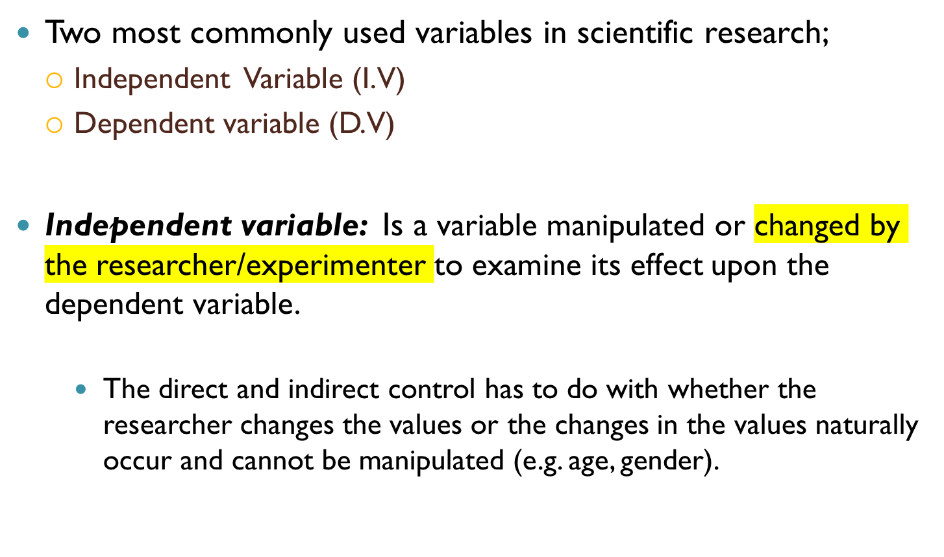
Types of Variables: Independent vs. dependent variable

Slide 16
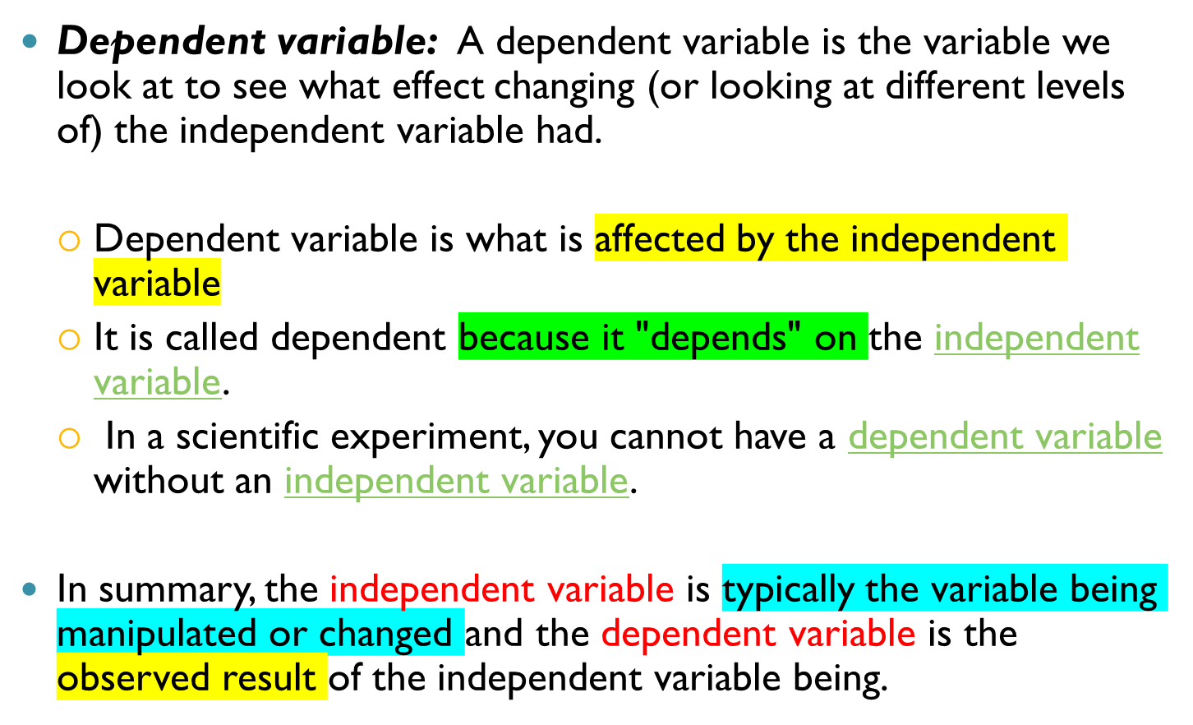
Types of Variables: Independent vs. dependent variable

Slide 17
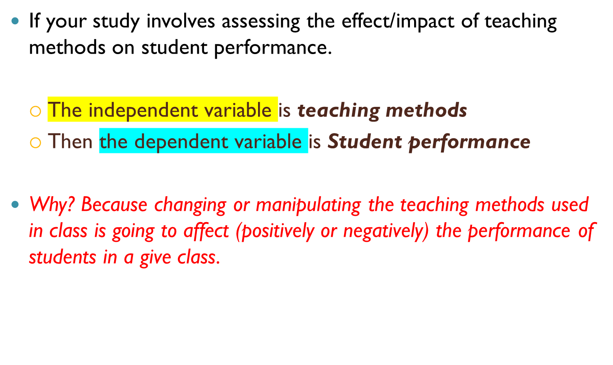
Examples

Slide 18
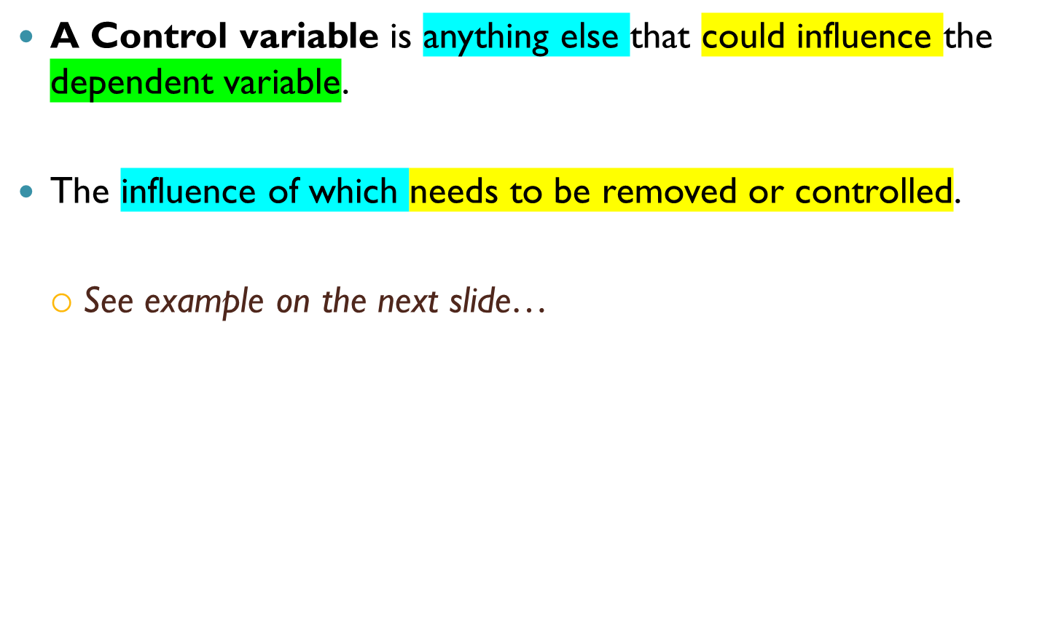
Control Variable

Slide 19
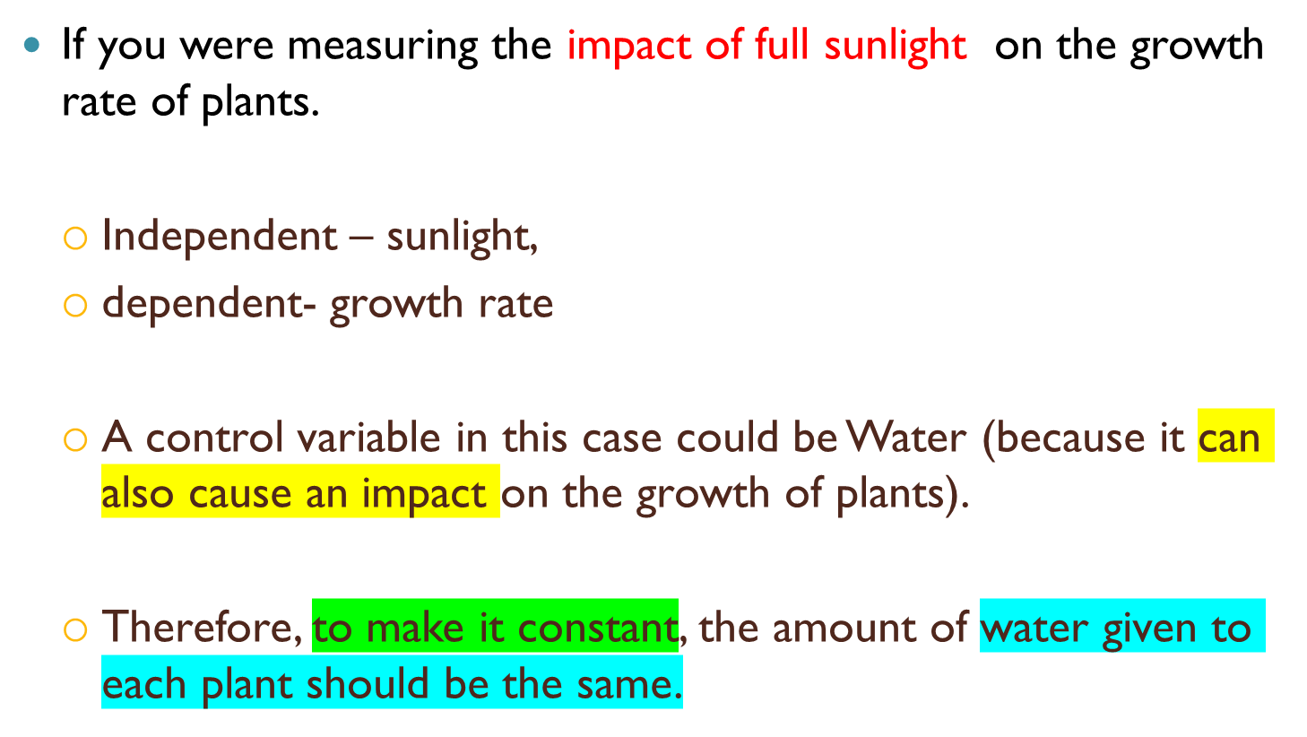
More examples

Slide 20
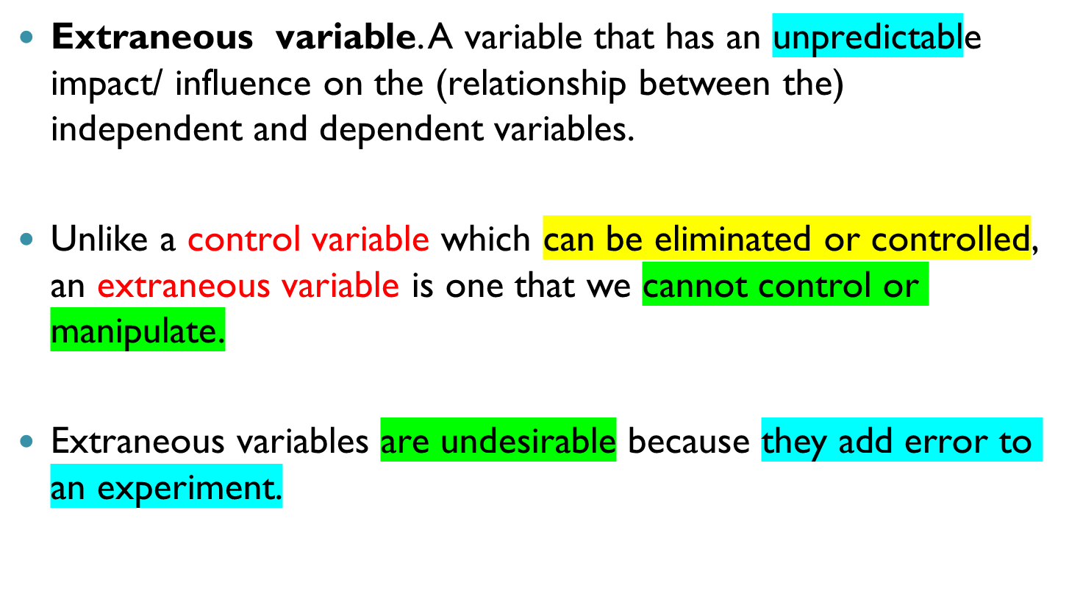
Extraneous Variable

Slide 21
Example
For example, let’s say that an educational psychologist has developed a new learning strategy and is interested in examining the effectiveness of this strategy.
The experimenter randomly assigns students to two groups. All of the students study text materials on a biology topic for thirty minutes.
One group uses the new strategy for studying and the other uses a strategy of their choice. Then all students complete a test over the materials.
One obvious extraneous variable in this case would be pre-knowledge of the biology topic that was studied.

Slide 22
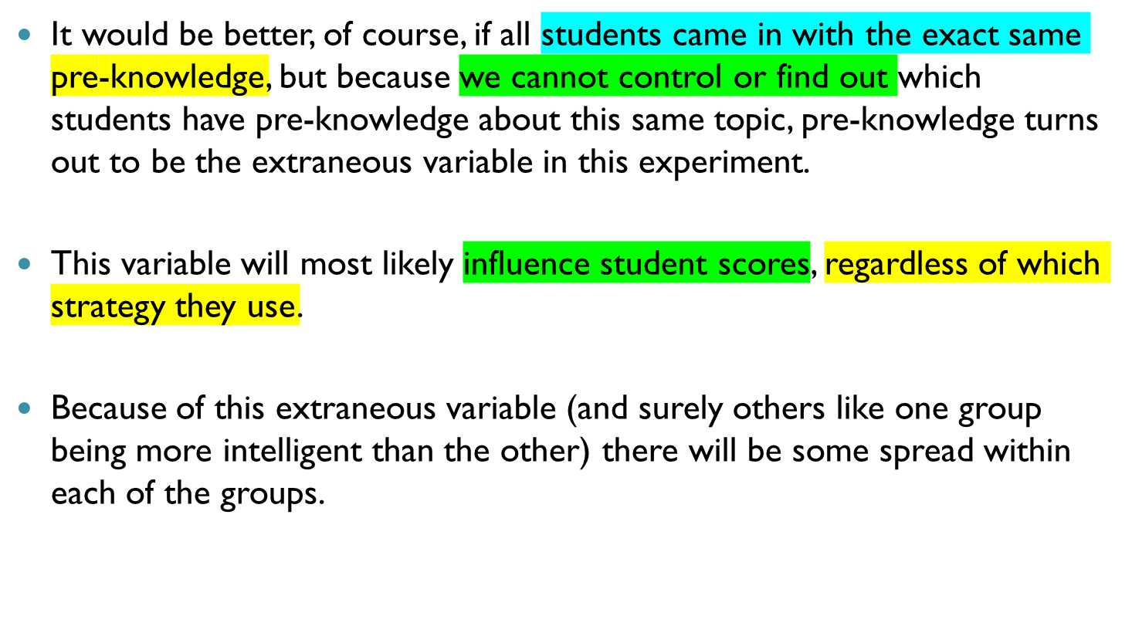
Example cont..d

Slide 23
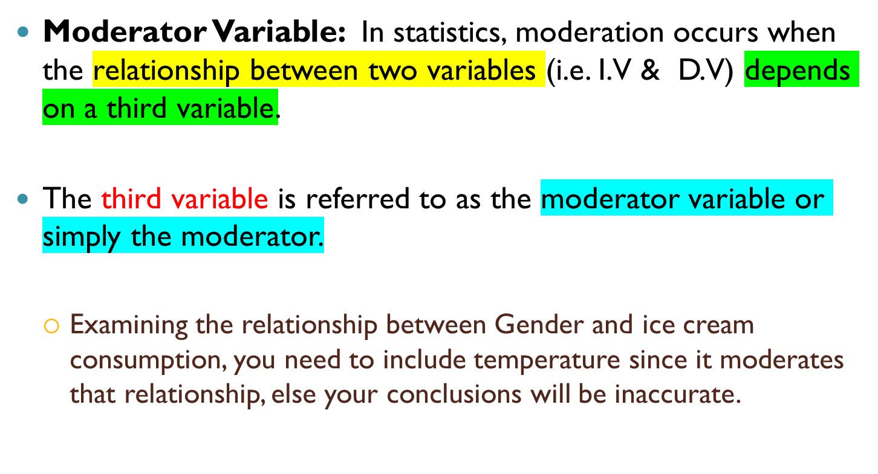
Moderator Variable

Slide 24
Summary on types of variables
Type of Variable | Definition | Other terms
Dependent | A variable measured to see whether a change of the independent variable had an effect | Outcome Variable Results variable Criterion
Independent | A variable manipulated to examine its impact on a dependent variable | Treatment variable Factor variable Predictor Variable
Control | A variable related to the dependent variable, the influence of which needs to be removed | Restricting Variable
Extraneous | A variable that has an unpredictable impact on the dependent or independent variable but is not part of the experiment | Threatening Variable
Moderator | A variable that makes the relationship between two variables (I.V & D.V) to depend on a third variable. | Interacting Variable

Slide 25
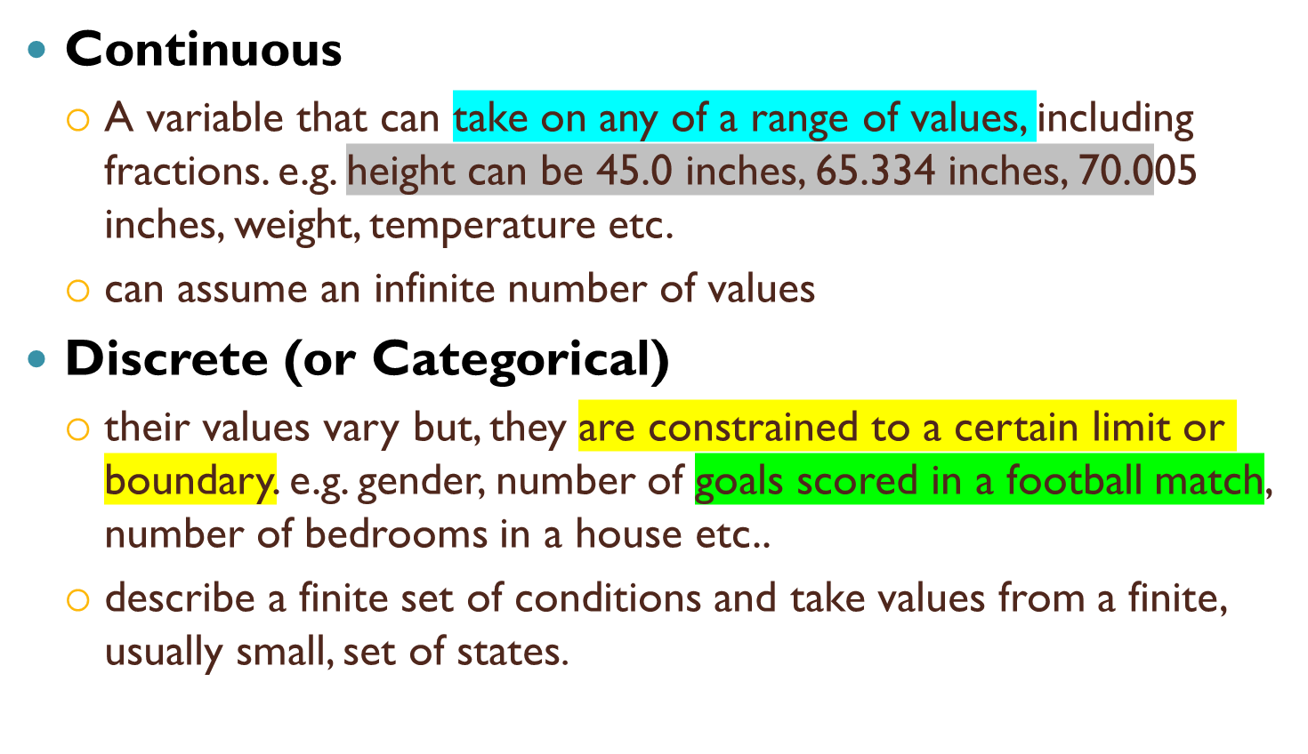
Continuous vs. Discrete Variables

Slide 26
Data Types
Numerical data
Characters and Strings

